Slide 1
Y11 Thinking about A Level Chemistry!
Welcome to presentation 1!
What to expect from these resources:
An outline of the course entry requirements and structure
A taste of what the content will look like
Clear structure to prepare for learning next year and help you “Bridge the Gap” from GCSE to A Level!
Learning goal | What is A Level Chemistry About?!
Prior knowledge | Combined or Triple Chemistry
Application | Identify what the entry requirements and course structure is Begin to prepare for the transition from GCSE to A Level using independent study resources

Slide 2
Entry Requirements:
Grade 6-6 or above in Combined Science GCSEs.
Two grade 6’s in Triple Science, including Chemistry.
Grade 6 or above in Maths GCSE
An aptitude and love for Science!!

Slide 3
Course Structure:
There is no such thing as “AS” and “A” Level any more. You will do all your formal, external exams at the end of Year 13.

Slide 4
Using these resources:
Download the workbook. You can use this to complete the tasks set!
It is up to you if you print it and hand write your answers, use it as a structure for written notes, or complete it on the computer.
The work book is split into three sections.
Each matches with one of three power points.
Work through each power point and complete the work book as you go through!

Slide 5
Using these resources:
I have made two copies of some slides.
If you look at the first slide and think “WHHAAAAT!?”
Go to the second slide, there will be an orange Hint Box there, with questions or video links to provide additional support
Hint:
Always be proactive, use the internet to find answers to questions. Don’t accept being confused and not knowing!

Slide 6
Using these resources:
REFLECT WHEN YOU ARE FINISHED:
Do you know what you want to do at university already?
If you do, great – you might know already that you need Chemistry
If you do not, not to worry but consider:
Is this content interesting?
As the content gets harder, will you still feel happy you chose it?
Does the maths bother you?

Slide 7
Presentation 1:
Essential Knowledge
for A Level Chemistry

Slide 8
A Level Chemistry builds on your GCSE knowledge.
Everyone finds the A Level Chemistry course difficult, but it is incredibly rewarding so stick at it!
This lesson summarises some of the key concepts from GCSE Chemistry which will help form the foundation of your study of the advanced material in A-Level.

Slide 9
Relative atomic mass (A_{r})
The weighted average of the masses of its isotopes relative to 1/12 of the mass of a carbon-12 atom. The relative atomic masses can be found in the periodic table
Relative molecular mass (M_{r})
The sum of the relative atomic masses of the atoms in the numbers shown in the formula.
In a balanced chemical equation, the sum of the relative formula masses of the reactants equals the sum of the relative formula masses of the products.
For example: 2Mg + O₂ → 2MgO
(2x24) + (2x16) → 2 x (24+16)
80 → 80
H₂SO₄
(2 x H + 1 x S + 4 x O)
A_{r}: H (1) S (32) O (16)
WORK OUT THE ANSWER!
Al₂(SO₄)₃
(2 x Al + 3 x S + 12 x O)
A_{r}: Al (27) S (32) O (16)
WORK OUT THE ANSWER!
Notes:
This slide could be used as a starter activity to ‘warm’ students up.
The two calculations are animated so that students can work out the answer and can then self-assess when you reveal the answer.

Slide 10
Hint:
Define isotope
Watch this video if you cannot remember RAM/RFM:
https://www.youtube.com/watch?v=it_fMQu5ivg
Watch this video for balancing equations:
https://www.youtube.com/watch?v=qquOFYOpdl0
Relative atomic mass (A_{r})
The weighted average of the masses of its isotopes relative to 1/12 of the mass of a carbon-12 atom. The relative atomic masses can be found in the periodic table
Relative molecular mass (M_{r})
The sum of the relative atomic masses of the atoms in the numbers shown in the formula.
In a balanced chemical equation, the sum of the relative formula masses of the reactants equals the sum of the relative formula masses of the products.
For example: 2Mg + O₂ → 2MgO
(2x24) + (2x16) → 2 x (24+16)
80 → 80
H₂SO₄
(2 x H + 1 x S + 4 x O)
A_{r}: H (1) S (32) O (16)
WORK OUT THE ANSWER!
Al₂(SO₄)₃
(2 x Al + 3 x S + 12 x O)
A_{r}: Al (27) S (32) O (16)
WORK OUT THE ANSWER!
Notes:
This slide could be used as a starter activity to ‘warm’ students up.
The two calculations are animated so that students can work out the answer and can then self-assess when you reveal the answer.

Slide 11
Relative atomic mass (A_{r})
The weighted average of the masses of its isotopes relative to 1/12 of the mass of a carbon-12 atom. The relative atomic masses can be found in the periodic table
Relative molecular mass (M_{r})
The sum of the relative atomic masses of the atoms in the numbers shown in the formula.
In a balanced chemical equation, the sum of the relative formula masses of the reactants equals the sum of the relative formula masses of the products.
For example: 2Mg + O₂ → 2MgO
(2x24) + (2x16) → 2 x (24+16)
80 → 80
H₂SO₄
(2 x H + 1 x S + 4 x O)
A_{r}: H (1) S (32) O (16)
M_{r} = (1x2) + 32 + (16x4) = 98
Al₂(SO₄)₃
(2 x Al + 3 x S + 12 x O)
A_{r}: Al (27) S (32) O (16)
M_{r} = (27x2) + (32x3) + (16x12) = 342
Notes:
This slide could be used as a starter activity to ‘warm’ students up.
The two calculations are animated so that students can work out the answer and can then self-assess when you reveal the answer.

Slide 12
Avogadro constant
Chemical amounts are measured in moles. The symbol for the unit mole is mol.
The mass of one mole of a substance in grams is numerically equal to its relative formula mass. One mole of a substance contains the same number of the stated particles, atoms, molecules or ions as one mole of any other substance.
The number of atoms, molecules or ions in a mole of a given substance is the Avogadro constant. The value of the Avogadro constant is 6.02 x 10²³ per mole.
For example, 1 mole of H₂O has a mass of 18g and contains :
6.02 x 10²³ water molecules
6.02 x 10²³ oxygen atoms
1.204 x 10²⁴ hydrogen atoms (2 x Avogadro)
Notes:
This slide and the previous one contain concepts that are essential for students to understand if they are going to be able to access the more complicated maths questions.

Slide 13
Avogadro constant
Chemical amounts are measured in moles. The symbol for the unit mole is mol.
The mass of one mole of a substance in grams is numerically equal to its relative formula mass. One mole of a substance contains the same number of the stated particles, atoms, molecules or ions as one mole of any other substance.
The number of atoms, molecules or ions in a mole of a given substance is the Avogadro constant. The value of the Avogadro constant is 6.02 x 10²³ per mole.
For example, 1 mole of H₂O has a mass of 18g and contains :
6.02 x 10²³ water molecules
6.02 x 10²³ oxygen atoms
1.204 x 10²⁴ hydrogen atoms (2 x Avogadro)
Hint:
You did this as part of your higher tier content. Watch this video to remind you:
https://www.youtube.com/watch?v=wPGVQu3UXpw
Notes:
This slide and the previous one contain concepts that are essential for students to understand if they are going to be able to access the more complicated maths questions.

Slide 14
Number of moles = mass (g) or mass (g)
A_{r} M_{r}
Mass (g) = number of moles x A_{r}
or number of moles x M_{r}
How many moles of sulfuric acid molecules are there in 4.7g of sulfuric acid (H₂SO₄)?
Give your answer to 1 significant figure.
WORK OUT THE ANSWER!
What is the mass of 7.2 x 10⁻³ moles of aluminium sulfate (Al₂(SO₄)₃)?
Give your answer to 1 decimal place.
WORK OUT THE ANSWER!
How many moles of calcium carbonate are there in 15g of CaCO₃?
Give your answer to 2 significant figures.
WORK OUT THE ANSWER!
What is the mass of 2.4 x 10⁻⁴ moles of magnesium hydroxide (Mg(OH)₂)?
Give your answer to 2 significant figures.
WORK OUT THE ANSWER!
Notes:
Each question is animated for self or peer assessment.
There is an opportunity here to check that students are clear on the difference between sig.figs. and decimal places

Slide 15
Number of moles = mass (g) or mass (g)
A_{r} M_{r}
Mass (g) = number of moles x A_{r}
or number of moles x M_{r}
How many moles of sulfuric acid molecules are there in 4.7g of sulfuric acid (H₂SO₄)?
Give your answer to 1 significant figure.
4.7 = 0.05 mol
98
What is the mass of 7.2 x 10⁻³ moles of aluminium sulfate (Al₂(SO₄)₃)?
Give your answer to 1 decimal place.
7.2 x 10⁻³ x 342 = 2.5g
How many moles of calcium carbonate are there in 15g of CaCO₃?
Give your answer to 2 significant figures.
15 = 0.15 mol
100
What is the mass of 2.4 x 10⁻⁴ moles of magnesium hydroxide (Mg(OH)₂)?
Give your answer to 2 significant figures.
2.4 x 10⁻⁴ x 58 = 0.014g
Notes:
Each question is animated for self or peer assessment.
There is an opportunity here to check that students are clear on the difference between sig.figs. and decimal places

Slide 16
Ideal Gas Equation
Pressure in pascals, Pa or newtons per square metre, Nm⁻²
Temperature in kelvin, K.
Add 273 to the temperature in degrees Celsius
pV = nRT
Volume in cubic metres, m³
(Not cm³ or dm³)
The gas constant
= 8.31441 JK⁻¹mol⁻¹
Hint:
https://www.youtube.com/watch?v=BxUS1K7xu30
Number of moles

Slide 17
Using the Ideal Gas Equation
Calculate the Celsius temperature of 2.49 moles of gas contained in a 1 m³ container at a pressure of 143 Pa.
p = 143000
V = 1000
R = 8.31441
n = 2.49
WORK OUT THE ANSWER!
Notes:
The workings and answer will appear after the question to allow for peer/self assessment

Slide 18
Using the Ideal Gas Equation
Calculate the Celsius temperature of 2.49 moles of gas contained in a 1 m³ container at a pressure of 143 Pa.
p = 143000
V = 1000
R = 8.31441
n = 2.49
143 x 1 = 2.49 x 8.31441 x T
143 = 20.703 x T
6.9 K = T
K = ºC + 273
ºC = K – 273 = -266ºC
Notes:
The workings and answer will appear after the question to allow for peer/self assessment

Slide 19
Empirical formula
The empirical formula tells you the simplest ratio of the various atoms present in a substance. For example the empirical formula of ethane (which has a molecular formula of C₂H₆)
would be CH_{3.}
Calculating empirical formulae
In an experiment, 6.2g of phosphorus combined with oxygen to form 14.2g of phosphorus oxide. Calculate the empirical formula of the oxide.
 |  | P | O
Step 1 | Mass of element in question
Step 2 | A_{r}
Step 3 | Number of moles
Step 4 | Divide by the smallest number from step 3
Step 5 | Ratio of elements
Step 6 | Multiply by 2 to get whole numbers
WORK OUT THE ANSWER!
Hint:
https://www.youtube.com/watch?v=lPLTLkn3dNU

Slide 20
Empirical formula
The empirical formula tells you the simplest ratio of the various atoms present in a substance. For example the empirical formula of ethane (which has a molecular formula of C₂H₆)
would be CH_{3.}
Calculating empirical formulae
In an experiment, 6.2g of phosphorus combined with oxygen to form 14.2g of phosphorus oxide. Calculate the empirical formula of the oxide.
 |  | P | O
Step 1 | Mass of element in question | 6.2g | 8.0g
Step 2 | A_{r} | 31 | 16
Step 3 | Number of moles | 6.2/31 = 0.2 | 8.0/16 = 0.5
Step 4 | Divide by the smallest number from step 3 | 0.2/0.2 = 1 | 0.5/0.2 = 2.5
Step 5 | Ratio of elements | 1 x P | 2.5 O
Step 6 | Multiply by 2 to get whole numbers | 2 x P | 5 x O
The empirical formula of the compound is P₂O₅

Slide 21
Hint:
https://www.youtube.com/watch?v=gfBcM3uvWfs
Molecular formula
The molecular formula gives the total number of atoms of each element present in a molecule of the substance.
If the empirical formula and relative molecular mass is known, the molecular formula can be calculated.
The empirical formula of ribose is CH₂O. The molar mass of this compound was determined to be 150g/mol. What is the molecular formula of ribose?
Step 1: Determine the molar mass of the empirical formula ➔
Step 2: Divide the given molar mass by your answer from step 1 ➔
Step 3: Multiply your empirical formula by your answer from step 2 ➔
WORK OUT THE ANSWER!

Slide 22
Molecular formula
The molecular formula gives the total number of atoms of each element present in a molecule of the substance.
If the empirical formula and relative molecular mass is known, the molecular formula can be calculated.
The empirical formula of ribose is CH₂O. The molar mass of this compound was determined to be 150g/mol. What is the molecular formula of ribose?
Step 1: Determine the molar mass of the empirical formula ➔ 12 + (2 x 1) + 16 = 30gmol⁻¹
Step 2: Divide the given molar mass by your answer from step 1 ➔ 150gmol⁻¹ / 30gmol⁻¹ = 5
Step 3: Multiply your empirical formula by your answer from step 2 ➔ C_{1x5}H_{2x5}O_{1x5} = C₅H₁₀O₅

Slide 23
Hint:
https://www.youtube.com/watch?v=hnawBsyZTc8
Percentage yield
Consider the following equation for the production of ammonia:
N₂ + 3H₂ → 2NH₃
From the equation, if you reacted 1 mol of N₂ with 3 mol H₂, you would make 2 mol of NH₃.
However, if you carried out this experiment you may only make 1.9 mol i.e. you do not get 100% yield.
How to calculate percentage yield
%$yield=\frac{actual yield}{theoretical yield}$ x 100
When 7.5g of N₂ reacts with an excess of H₂, the actual yield of ammonia is 1.72g. Calculate the percentage yield.
Reasons for less than 100% yield
Reactions are reversible
Side reactions
Errors in experimental procedures
WORK OUT THE ANSWER!
Notes:
Slide is animated to allow for peer/self assessment

Slide 24
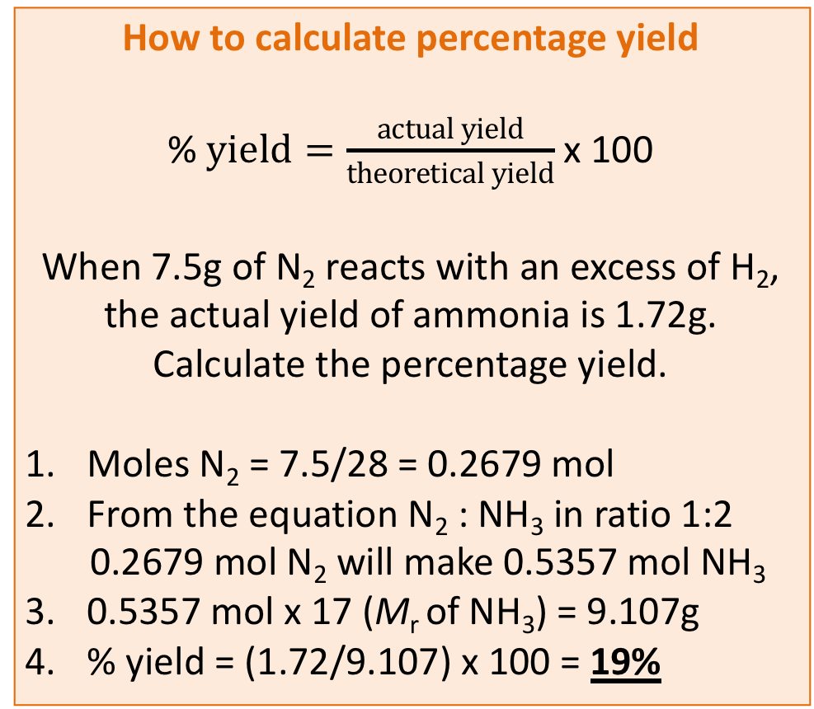
Percentage yield
Consider the following equation for the production of ammonia:
N₂ + 3H₂ → 2NH₃
From the equation, if you reacted 1 mol of N₂ with 3 mol H₂, you would make 2 mol of NH₃.
However, if you carried out this experiment you may only make 1.9 mol i.e. you do not get 100% yield.
How to calculate percentage yield
%$yield=\frac{actual yield}{theoretical yield}$ x 100
When 7.5g of N₂ reacts with an excess of H₂, the actual yield of ammonia is 1.72g. Calculate the percentage yield.
Moles N₂ = 7.5/28 = 0.2679 mol
From the equation N₂ : NH₃ in ratio 1:2
0.2679 mol N₂ will make 0.5357 mol NH₃
0.5357 mol x 17 (M_{r} of NH₃) = 9.107g
% yield = (1.72/9.107) x 100 = 19%
Reasons for less than 100% yield
Reactions are reversible
Side reactions
Errors in experimental procedures
Notes:
Slide is animated to allow for peer/self assessment

Slide 25
Hint:
https://www.youtube.com/watch?v=Zuyk4hfbjSA
Percentage atom economy
Atom economy is a measure of the amount of starting materials that end up as useful products. It is important for sustainable development and for economic reasons to use reactions with high atom economy. The percentage atom economy is calculated using the following equation:
Relative formula mass of desired product from equation x 100
Sum of relative formula mass of all reactants from equation
Calculate the atom economy for making hydrogen by reacting zinc with hydrochloric acid:
Zn + 2HCl → ZnCl₂ + H₂
WORK OUT THE ANSWER!
This method is unlikely to be chosen as it has a low atom economy.
The less waste there is, the higher the atom economy, the less materials are wasted, less energy used, so making the process more economic, 'greener' and sustainable.
Notes:
Slide is animated to allow for peer/self assessment

Slide 26
Percentage atom economy
Atom economy is a measure of the amount of starting materials that end up as useful products. It is important for sustainable development and for economic reasons to use reactions with high atom economy. The percentage atom economy is calculated using the following equation:
Relative formula mass of desired product from equation x 100
Sum of relative formula mass of all reactants from equation
Calculate the atom economy for making hydrogen by reacting zinc with hydrochloric acid:
Zn + 2HCl → ZnCl₂ + H₂
M_{r} of H₂ = 1 + 1 = 2
M_{r} of Zn = 65, M_{r} of 2HCl = 73 giving a total of 65 + 73 = 138
Atom economy = ²∕₁₃₈ × 100 = 1.45%
This method is unlikely to be chosen as it has a low atom economy.
The less waste there is, the higher the atom economy, the less materials are wasted, less energy used, so making the process more economic, 'greener' and sustainable.
Notes:
Slide is animated to allow for peer/self assessment

Slide 27
Concentration
The concentration of a solution is the amount of solute per volume of solution.
Chemists measure concentration in moles per cubic decimetre (mol/dm³).
Concentration = amount (mol)
(mol/dm³) volume (dm³)
What is the concentration of a solution that has 35.0g of solute in 0.5dm³ of solution?
WORK OUT THE ANSWER!
Calculate the mass of magnesium chloride (MgCl₂) if there is 1 dm³ of a 1mol/ dm³ solution.
WORK OUT THE ANSWER!
If the volumes of two solutions that react completely are known and the concentrations of one solution is known, the concentration of the other solution can be calculated.
Notes:
There is opportunity here to double check students understanding of the previously mentioned moles work and Avogardo constant.
Do pupils understand that the equation for concentration can be worked out from the units for concentration?

Slide 28
Concentration
The concentration of a solution is the amount of solute per volume of solution.
Chemists measure concentration in moles per cubic decimetre (mol/dm³).
Concentration = amount (mol)
(mol/dm³) volume (dm³)
What is the concentration of a solution that has 35.0g of solute in 0.5dm³ of solution?
35/0.5 = 70 g/dm³
Calculate the mass of magnesium chloride (MgCl₂) if there is 1 dm³ of a 1mol/ dm³ solution.
Mass of 1 mole of magnesium chloride = 24 + (35.5 × 2) = 95 g So there are 95 g of magnesium chloride in 1 dm³ of a 1 mol/dm³ solution.
If the volumes of two solutions that react completely are known and the concentrations of one solution is known, the concentration of the other solution can be calculated.
Notes:
There is opportunity here to double check students understanding of the previously mentioned moles work and Avogardo constant.
Do pupils understand that the equation for concentration can be worked out from the units for concentration?

Slide 29
2NaOH(aq) + H₂SO₄(aq)→ Na₂S0₄(aq) + 2H₂O(l)
It takes 12.20cm³ of sulfuric acid to neutralise 24.00cm³ of sodium hydroxide solution, which has a concentration of 0.50mol/dm³. Calculate the concentration of the sulfuric acid in g/dm³
WORK OUT THE ANSWER!
The equation shows that 2 mol of NaOH reacts with 1 mol of H₂SO₄, so the number of moles in 12.20cm³ of sulfuric acid is
WORK OUT THE ANSWER!
Calculate the concentration of sulfuric acid in mol/ dm³
WORK OUT THE ANSWER!
Calculate the concentration of sulfuric acid in g/ dm³
WORK OUT THE ANSWER!
Notes:
Students could be allowed to work through each section and check understanding before moving onto the next.
If pupils are struggling to remember the method from GCSE, it may be worthwhile spending some time looking at 1:1 ratios (using hydrochloric or nitric acid) first, before moving onto diprotic acids.

Slide 30
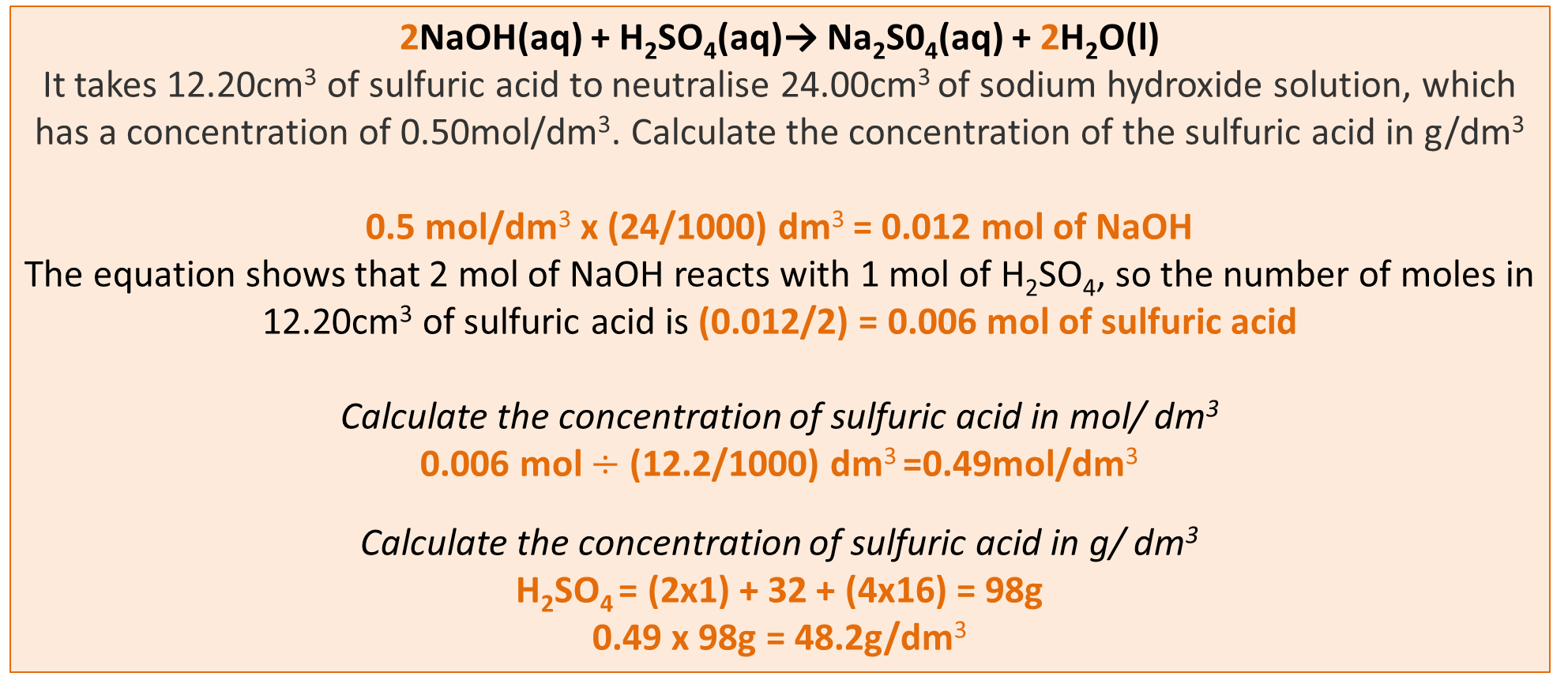
2NaOH(aq) + H₂SO₄(aq)→ Na₂S0₄(aq) + 2H₂O(l)
It takes 12.20cm³ of sulfuric acid to neutralise 24.00cm³ of sodium hydroxide solution, which has a concentration of 0.50mol/dm³. Calculate the concentration of the sulfuric acid in g/dm³
0.5 mol/dm³ x (24/1000) dm³ = 0.012 mol of NaOH
The equation shows that 2 mol of NaOH reacts with 1 mol of H₂SO₄, so the number of moles in 12.20cm³ of sulfuric acid is (0.012/2) = 0.006 mol of sulfuric acid
Calculate the concentration of sulfuric acid in mol/ dm³
0.006 mol $÷$ (12.2/1000) dm³ =0.49mol/dm³
Calculate the concentration of sulfuric acid in g/ dm³
H₂SO₄ = (2x1) + 32 + (4x16) = 98g
0.49 x 98g = 48.2g/dm³
Notes:
Students could be allowed to work through each section and check understanding before moving onto the next.
If pupils are struggling to remember the method from GCSE, it may be worthwhile spending some time looking at 1:1 ratios (using hydrochloric or nitric acid) first, before moving onto diprotic acids.

Slide 31
Calculating uncertainty in a burette
Uncertainty is an estimate attached to a measurement which characterises the range of values within which the true value lies e.g. 44.0 $± 0.4$
For a burette:
Graduated in division every 0.1 cm³
Maximum error is half a division i.e. $±$ 0.05 cm³
Burettes are read twice, so the overall maximum error is 2 x 0.05 = $±$0.1 cm³

