Slide 1
Y11 Thinking about A Level Chemistry!
Welcome to presentation 3!
What to expect from these resources:
A taste of what the content will look like
Clear structure to prepare for learning next year and help you “Bridge the Gap” from GCSE to A Level!
Learning goal | What is A Level Chemistry About?!
Prior knowledge | Combined or Triple Chemistry
Application | Begin to prepare for the transition from GCSE to A Level using independent study resources

Slide 2
Presentation 3:
Essential Knowledge
for A Level Chemistry

Slide 3
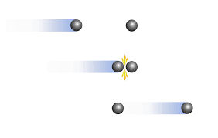
Simple collision theory
If a chemical reaction is to take place between two particles, they must first collide. The number of collisions between particles per unit time in a system is known as the collision frequency of the system.
The collision frequency of a given system can be altered by changing the concentration of the reactants, the total pressure, the temperature or the size of the reacting particles.
The minimum energy the colliding particles need in order to react is known as the activation energy.
If the collision energy of the colliding particles is less than the activation energy, the collision will be unsuccessful.
If the collision energy is equal to or greater than the activation energy, the collision will be successful and a reaction will take place.
Notes:
Can pupils define activation energy?

Slide 4
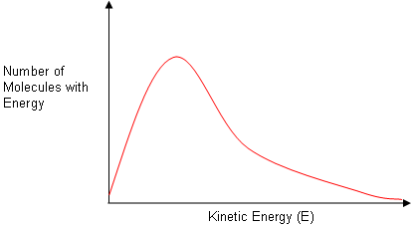
Hint:
https://www.youtube.com/watch?v=xQ9D4Jz95-A
Simple collision theory
Not all the particles in a given system have the same energy; they have a broad distribution of different energies.
The distribution of molecular energies at a characteristic temperature T₁ can be represented graphically. It is known as a Maxwell-Boltzmann distribution:

Slide 5
Rate of reaction and temperature
An increase in temperature changes the distribution of molecular energies so there is an increase the mean kinetic energy of the particles and therefore an increase in the collision energy.
An increase in temperature will increase the number of colliding particles with an energy equal to or greater than the activation energy.
Draw a Maxwell-Boltzmann distribution graph to show the molecular energies at 20ºC and 40ºC.
WORK OUT THE ANSWER!
Notes:
Pupils can draw the graph and then peer/self assess.

Slide 6
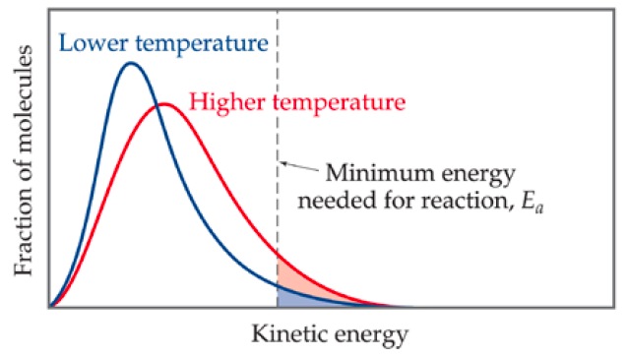
Rate of reaction and temperature
An increase in temperature changes the distribution of molecular energies so there is an increase the mean kinetic energy of the particles and therefore an increase in the collision energy.
An increase in temperature will increase the number of colliding particles with an energy equal to or greater than the activation energy.
Draw a Maxwell-Boltzmann distribution graph to show the molecular energies at 20ºC and 40ºC.
Notes:
Pupils can draw the graph and then peer/self assess.

Slide 7
Rate of reaction and concentration
The greater the concentration of the species in a liquid or gaseous mixture, the greater the number of species per unit volume and the greater the collision frequency.
The collision energy, activation energy and the fraction of successful collisions are unaffected.
An increase in concentration increases the rate of reaction because
An increase in concentration causes the rate of reaction to increase by increasing the collision frequency.
WHY?
EXPLAIN THE ANSWER!
Notes:
Can pupil explain why concentration increases rate? Peer/self assess

Slide 8
Rate of reaction and concentration
The greater the concentration of the species in a liquid or gaseous mixture, the greater the number of species per unit volume and the greater the collision frequency.
The collision energy, activation energy and the fraction of successful collisions are unaffected.
An increase in concentration increases the rate of reaction because
- the number of particles per unit volume increases
- so the collision frequency increases
An increase in concentration causes the rate of reaction to increase by increasing the collision frequency.
Notes:
Can pupil explain why concentration increases rate? Peer/self assess

Slide 9
Rate of reaction and pressure
The greater the pressure in a gaseous mixture, the greater the number of species per unit volume and the greater the frequency collision.
The collision energy, activation energy and hence the fraction of successful collisions are unaffected.
An increase in pressure increases the rate of reaction because
An increase in pressure causes the rate of reaction to increase by increasing the collision frequency. The pressure of a system is generally increased by reducing its volume.
WHY?
EXPLAIN THE ANSWER!
Notes:
Can pupil explain why pressure increases rate? Peer/self assess

Slide 10
Rate of reaction and pressure
The greater the pressure in a gaseous mixture, the greater the number of species per unit volume and the greater the frequency collision.
The collision energy, activation energy and hence the fraction of successful collisions are unaffected.
An increase in pressure increases the rate of reaction because
- the number of particles per unit volume increases
- so the collision frequency increases
An increase in pressure causes the rate of reaction to increase by increasing the collision frequency. The pressure of a system is generally increased by reducing its volume.
Notes:
Can pupil explain why pressure increases rate? Peer/self assess

Slide 11
Rate of reaction and catalyst
A catalyst is a substance which changes the rate of a chemical reaction without itself being chemically altered at the end of the reaction.
Catalysts provide an alternative reaction pathway, usually by introducing an extra step into the reaction, which has a lower activation energy than the uncatalysed reaction.
Draw a Maxwell-Boltzmann distribution graph to show the molecular energies of a catalysed and uncataylsed reaction.
WORK OUT THE ANSWER!
Notes:
Pupils can draw the graph and then peer/self assess.
Make sure pupils are clear that catalysts do not lower the activation energy, but provide an alternative path with a lower activation energy

Slide 12
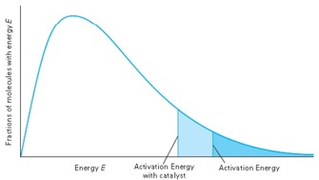
Rate of reaction and catalyst
A catalyst is a substance which changes the rate of a chemical reaction without itself being chemically altered at the end of the reaction.
Catalysts provide an alternative reaction pathway, usually by introducing an extra step into the reaction, which has a lower activation energy than the uncatalysed reaction.
Draw a Maxwell-Boltzmann distribution graph to show the molecular energies of a catalysed and uncataylsed reaction.
Notes:
Pupils can draw the graph and then peer/self assess.
Make sure pupils are clear that catalysts do not lower the activation energy, but provide an alternative path with a lower activation energy

Slide 13
Hint:
https://www.youtube.com/watch?v=g5wNg_dKsYY
Dynamic equilibrium
“Dynamic” = the reaction has not stopped; it is simply moving in both directions at the same rate.
“Equilibrium” = the amount of reactants and products in the system is staying the same.
In reversible reactions, the rate of the forward reaction decreases and the rate of the reverse reaction increases. Eventually, the reaction will reach a stage where both forward and backward reactions are proceeding at the same rate.
At this stage, a dynamic equilibrium has been reached.
Notes:
Give pupils five minutes to define open and closed systems and how these affect equilibrium.

Slide 14
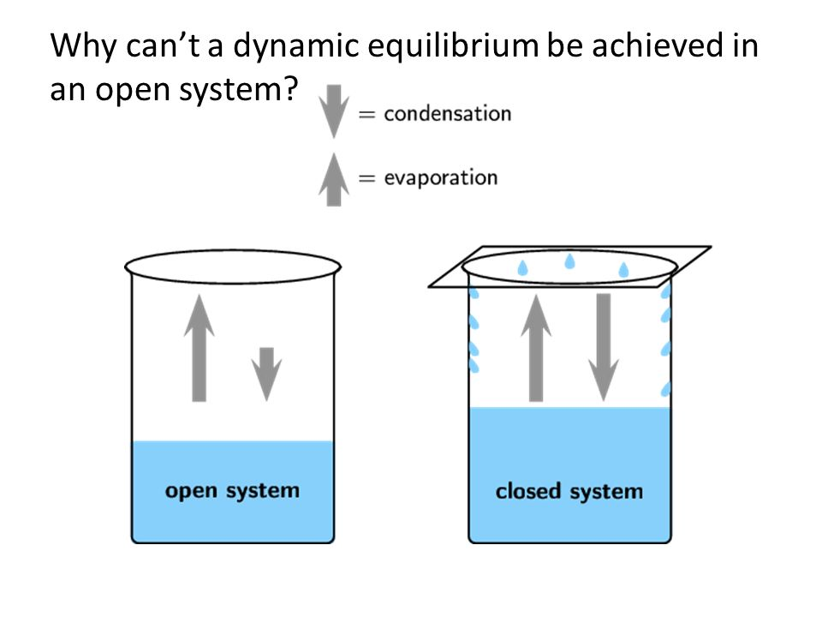
Dynamic equilibrium
A closed system is one from which reactants and products cannot escape.
In closed systems the forward and reverse reactions continue until dynamic equilibrium is reached. All reactions in a closed system are therefore reversible.
Notes:
Give pupils five minutes to define open and closed systems and how these affect equilibrium.

Slide 15
Dynamic equilibrium
An open system is one from which reactants and products can escape.
In an open system, the products are removed as soon as they are formed, so the reverse reaction is not able to take place. Such reactions never reach equilibrium, but proceed until all the reactions have been converted into products.
Notes:
Give pupils five minutes to define open and closed systems and how these affect equilibrium.

Slide 16
Le Chatelier’s Principle
If a constraint is imposed on a system at equilibrium, then the system will respond in such a way as to counteract the effect of that constraint.
If the conditions are changed after equilibrium has been established, the system may no longer be at equilbrium and may move in one direction or another to re-establish equilibrium.
The direction in which the system will move to re-establish equilibrium can be predicted by Le Chatelier's principle.

Slide 17
/’[]=p-
Le Chatelier’s Principle - Concentration
Le Chatelier's principle predicts that if a reactant's concentration in a system is increased, the system will move to the right in order to decrease the concentration of that reactant.
If the reactant's concentration is decreased, the system will move to the left in order to replace that reactant. Similarly, if a product's concentration is increased then the system will move to the left and if a product's concentration is decreased then the system will move to the right.
N₂ + 3H₂ $⇌$2NH₃
Increasing the concentration of nitrogen has what effect on the position of equilibrium and the yield of ammonia?
Notes:
Give pupils a few minutes to answer the question, discuss any misunderstandings.

Slide 18
Le Chatelier’s Principle - Pressure
The pressure in a system depends on the number of gas molecules in the system.
Le Chatelier's principle predicts that if the pressure of the system is increased, the system will move towards the side which has fewer gas moles.
If the pressure of the system is decreased, the system will move towards the side which has more gas moles.
If the number of gas moles on both sides is the same, then pressure has no effect on the equilibrium position.
N₂ + 3H₂ $⇌$2NH₃
Increasing the pressure has what effect on the position of equilibrium and the yield of ammonia?
Notes:
Give pupils a few minutes to answer the question, discuss any misunderstandings.

Slide 19
Le Chatelier’s Principle - Temperature
If the forward reaction is exothermic, then the temperature of the system will rise if the forward reaction takes place. The reverse reaction will therefore be endothermic, and the temperature of the system will fall if the reverse reaction takes place.
Le Chatelier's principle predicts that an increase in temperature will favour the endothermic reaction, and that a decrease in temperature will favour the exothermic reaction.
N₂ + 3H₂ $⇌$2NH₃ $∆$H = -92 kJ mol⁻¹
What effect does increasing the temperature have on the yield of ammonia?
Explain why.
Notes:
Give pupils a few minutes to answer the question, discuss any misunderstandings.

Slide 20
Le Chatelier’s Principle - Catalyst
The addition of a catalyst will have no effect on the position of equilibrium.
It will increase the rate of the forward and reverse reactions, but by the same amount. The position of equilibrium will therefore be unchanged.
As the position of equilibrium is unchanged, it follows that adding a catalyst has no effect on the equilibrium constant.

