Slide 1
PBE Study Skills and Assessment
Summarising and note-taking
Exam criteria
Understanding the question
Introductions
Starter sentences and connectives
Paragraphs
Conclusions
When we summarise in our notes, we aim to keep necessary detail but reduce length…
A cupcake, also known as a fairy cake, is a small cake designed to serve one person, which may be baked in a small thin paper or aluminium cup. As with larger cakes, icing and other cake decorations, such as candy, may be applied. The first mention of the cupcake can be traced as far back as 1796.
In the early 19th century, there were two different uses for the name cup cake or cupcake. In previous centuries, before muffin tins were widely available, the cakes were often baked in individual pottery cups, ramekins, or moulds and took their name from the cups they were baked in. This is the use of the name that has remained, and the name of "cupcake" is now given to any small cake that is about the size of a teacup. While English fairy cakes vary in size more than American cupcakes, they are traditionally smaller and are rarely topped with elaborate icing.
The other kind of "cup cake" referred to a cake whose ingredients were measured by volume, using a standard-sized cup, instead of being weighed.
Record definitions in a shortened version that you will be able to remember
Avoid remembering dates – this is unnecessary for the PBE exam. If you want to include a reference to dates, remember the century only
Record information as bullet points or numbered information – this will help you to remember the key points in an exam
Write down important ideas in shortened form but in such a way that you will be able to expand on points again later in an essay
Cupcake, first discussed 18th century
Serves one, size of teacup
Can be decorated e.g. icing, candy
Before muffin tins were widely available, often baked in cups, ramekins or moulds – name taken from what they were baked in
English version: traditionally smaller, less elaborate icing
2 uses – small cake or cake measured by volume using standard cup

Slide 2
There are two parts to the EXAM CRITERIA. In the exam, AO1 refers to EXPLANATION. Candidates are required to demonstrate knowledge and understanding of beliefs, including religious, philosophical and/or ethical thought and teaching and how these influence the beliefs and practices of individuals, communities and societies. It also includes the ability to explain cause and significance of similarities and differences in belief, teaching and practice and different approaches to the study of religion and belief. AO2 refers to EVALUATION. This is the ability to analyse and evaluate aspects of, and approaches to, religion and belief including their significance, influence and study.
Features of an A Grade essay at AS is described as having ‘a very good demonstration of knowledge and understanding in response to the question (AO1)’ and ‘a very good demonstration of analysis and evaluation in response to the question (AO2).’
 | Focuses on the precise question throughout
 | Has a very good selection of relevant material which is used appropriately
 | Shows that the candidate has accurate, and detailed knowledge which demonstrates very good understanding through either the breadth or depth of material used
 | Uses technical terms and subject vocabulary accurately and appropriately
 | Uses a very good range of scholarly views, academic approaches, and/or sources of wisdom and authority to demonstrate knowledge and understanding
 | A clear and convincing argument
 | Successful and clear analysis and evaluation
 | Views very well stated, coherently developed and justified
 | Shows a well–developed and sustained line of reasoning which is coherent, relevant and logically structured

Slide 3
Features of an A* Grade essay at A2 is described as having ‘an excellent demonstration of knowledge and understanding in response to the question (AO1)’ and ‘an excellent demonstration of analysis and evaluation in response to the question (AO2).’
 | Fully comprehends the demands of, and focusses on, the question throughout
 | Excellent selection of relevant material which is skillfully used
 | Accurate and highly detailed knowledge which demonstrates deep understanding through a complex and nuanced approach to the material used
 | Thorough, accurate and precise use of technical terms and vocabulary in context
 | Extensive range of scholarly views, academic approaches, and/or sources of wisdom and authority are used to demonstrate knowledge and understanding
 | Excellent, clear and successful argument
 | Confident and insightful critical analysis and detailed evaluation of the issue
 | Views skillfully and clearly stated, coherently developed and justified
 | There is an excellent line of reasoning, well-developed and sustained, which is coherent, relevant and logically structured.
At AS, 15 marks are allocated for AO1 and 15 marks are allocated for AO2. At A2, 16 marks are allocated for AO1 and 24 marks are allocated for AO2.
You will also be expected to refer to more scholars, show a more detailed understanding of the literature, criticise and analyse material much more and use a more nuanced approach whereby you focus even more on the ‘grey areas’ and the choice of words used in the question. Throughout your essay, there should be sustained and well-developed reasoning before reaching your conclusion. This can all be done at AS to improve essays but will be vital at A2.

Slide 4
When you are trying to understand a question, think about the command words used. It can help you to re-write the question in a simple way or even plan your essay around the title of the question. Remember that the examiners write and re-write these exam papers A LOT, so if a word has been included, it is important!
Assess the view that everyone should have cupcakes.
What is the COMMAND WORD used? It will always involve an element of evaluation
The word ‘everyone’ is key – this is, again, encouraging you to critique all-or-nothing views
Assess the extent to which everyone should have cupcakes.
The word EXTENT encourages you to think of the ‘grey area’ and the many different responses on a spectrum that are available for discussion
The question outlines the field of study – you could bullet point the definitions and key ideas that you will discuss.
Sample planning around the question: highlight the key words…
Write out the definitions and key ideas you will discuss. Remember to include scholars and, if you think you will forget them, quotations. You can do this for every question before you begin your exam so that you don’t forget key details later. Finally, number the key ideas to help you remember which order you will write them up in. In PBE, you should explain and criticise within paragraphs. For each criticism, you could write down in brackets the relevant explanation points you will give. You can also match up linked ideas with arrows.
Assess the extent to which everyone should have cupcakes.
YES | NO | ‘GREY AREA’
3.6 billion industry (1) Taste good (3) Bentham ‘pleasure principle’ (3) | Diabetes (2) Obesity (2) Mill (4) Kant (5) | Issues with Kant & Freedom of choice (6) C: Not everyone should, but everyone could

Slide 5
Once you have written your plan, the introduction should be relatively easy to write. There are no set rules for how to write a good essay but these tips can be useful! Start by unpicking definitions and outlining what the question is asking or the problem at hand (A). There might be several possible interpretations of the question. Then outline the main arguments for and against the statement. You could just pick one on each side to outline. Leave out your favourite argument (B). Summarise your strongest argument in first or third person, depending on your preference (C).
Assess the extent to which everyone should have cupcakes.
YES | NO | ‘GREY AREA’
3.6 billion industry (1) Taste good (3) Bentham ‘pleasure principle’ (3) | Diabetes (2) Obesity (2) Mill (4) Kant (5) | Issues with Kant & Freedom of choice (6) C: Not everyone should but everyone could
The first reference to cupcakes can be found in the 19th century in America. Their growing popularity has culminated in a 3.6 billion dollar industry today. Whilst the cakes are popular due to their sweet taste, one can question the claim that everyone should eat them given the rise in diabetes and obesity in the Western world (A). Whilst Bentham would argue that everyone should be able to do what brings about the most pleasure, scholars such as Kant and Mill outline the need for rules and would, in all likelihood, argue that everyone ought not to have cupcakes (B). Whilst there is merit to suggesting that cupcakes should be avoided, it seems that it would be preferable to give people freedom of choice, rather than state that they must or must not eat cupcakes (C).
DEFINE
Key terms and the question
ARGUMENTS
Strongest on either side apart from your own
OVERALL
What you will be arguing is the strongest argument

Slide 6
Varying language and using a range of sentence starters and connectives can improve the quality of your essay. Writing longer sentences does not make your essay better! Try and find the most appropriate words to keep sentences concise and clear. Longer sentences can be broken up using semi-colons.
EXAMPLES For example… As exemplified by… Such as… Including… As is shown by… In the case of… This is suggested by… In the case of… | CONTRASTING With regards to… By contrast… However… On the other hand… Despite this… Although… Whereas… Concerning…
SUGGESTING This suggests… This shows… This demonstrates… It is clear that… One can argue that… This emphasises… As a result… Since… then… | ADDING POINTS In addition… Moreover… In the same way… Equally… As with… More importantly… First, secondly, thirdly… Furthermore…
CONCESSION Whilst it is true that.. Despite the fact that… In spite of… Despite this… However… Nevertheless… Although… Whilst one can argue that… | SUMMARISING In other words… Put simply… That is… Overall… Thus… In sum… In conclusion… The strongest argument is…
Example sentences using these terms:
Bentham’s argument comprises of three parts: first, his use of the principle of utility; second, his understanding of pleasure and pain; and, finally, his application of the hedonic calculus.
Whilst Bentham attempted to create a clear ethical framework, Mill argued that it would be far clearer to use rules of thumb to ascertain the morality of an action.
Bentham argued that the morality of an action is determined by the amount of pleasure it produces. In the case of cupcakes, if eating a cupcake will produce the greatest aggregate happiness, it ought to be done.

Slide 7
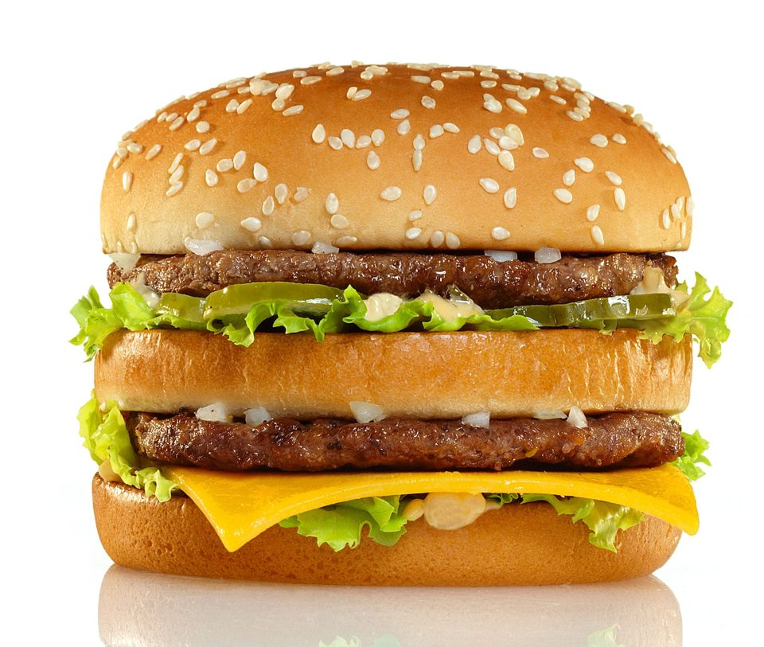
There is no set formula for writing a good essay, since people may have widely different styles. That said, when writing paragraphs there are key features that ought to be included. Each paragraph should begin with a clear POINT that is highly relevant to the question. The point should then be EXEMPLIFIED and EXPLAINED. Using SCHOLARS and QUOTATIONS adds depth. The point should then be ANALYSED and EVALUATED. Finally, the point should be returned to in a summary sentence that LINKS BACK to the title of the question. This, again, ensures that all information is relevant and sufficiently explained.
TOP BUN: THE POINT
Give a clear point that is highly relevant to the question.
FILLINGS: SCHOLARS, EVIDENCE, EXPLANATION, ANALYSIS
Give examples that support the point or that show key aspects of a theory. For example…
Refer to scholars that are relevant, including shortened versions of quotes. He argues that…
Explain these examples and the theory further. This entails…
Analyse by commenting on the strength of an argument. This is a significant argument because…
BOTTOM BUN: THE LINK
Link back to the question. This shows that…
AND REPEAT: Follow the same steps for the EVALUATION.
You can evaluate a point in the same paragraph as part of your analysis (like a DOUBLE MAC), or in a separate paragraph you are going to write a lot about the opposing theory.

Slide 8
Conversely, one could argue that nobody should have cupcakes given their high sugar content. The World Health Organisation estimates that one in four people in the Western world is obese and that consequences of this include a shortening of the life span. The scientist Robert Lustig "Politicians have to come in and reset the playing field” by which he means politicians must make it much harder for companies to sell sugary goods in order to help reduce the epidemic caused by foods such as cupcakes. Despite widely available medicine, people have begun to present with a number of health problems as a result of eating fatty and sugary foods regularly, including tooth decay, diabetes and, albeit less frequently, heart disease. This is a significant argument given the rising cost for government in treating these health problems. It may be, then, that politicians must ban sugary foods such as cupcakes rather than encourage everyone to do it.
The paragraph begins with clear point that relate to the whole argument
Scholars and sources of wisdom are referred to and examples are given to emphasise the point
The meaning of these examples and ideas is further explained
The argument is analysed and the significance of it is considered
The question is referred to again at the end
Nuance is considered by analysing theories in more detail and re-phrasing the question statement
On the other hand, banning cupcakes would involve limiting freedom of choice. Mill argues that freedom is the greatest good and can never be limited by government so long as the free choices made are not harming society, only the individual. This is because personal autonomy is a greater good than controlling health. Even Lustig does not argue that these goods must necessarily be banned, but, rather, controlled so that companies make less money from selling them. One could also put people off buying cupcakes by charging more tax on sugary products. Thus, whilst it would be wrong to suggest that everyone should consume cupcakes, claiming that nobody should be allowed to is also wrong. Perhaps, the term ‘should’ should be understood as a recommendation, instead, whereby people can buy cupcakes but ought not to since they will harm their bodies.

Slide 9
Your conclusion is an opportunity to revisit your arguments throughout the essay. Some people like to give their strongest argument in the conclusion whilst others prefer to give their strongest argument before the conclusion and just summarise the whole argument again at the end. Make sure that you do not just restate your points very simply as this will not add anything to your essay! The conclusion will share a lot of similarities with your introduction. Many people also like to use first person in the conclusion to emphasise that it is their own favoured argument. Conclusions are very important so make sure you leave time at the end. It is also important to make sure that you evaluate and reach mini-judgements throughout the essay, rather than leave this all to the conclusion.
RE-STATE
What was the question asking you?
SUMMARISE
What were some of the best arguments?
INTERPRET
Does your conclusion depend on interpretation of the question?
EMPHASISE
Why is your argument the strongest?
Overall, I would argue it would be wrong to say that everyone should have cupcakes. First, one must consider what the effects would be individuals, such as those who have diabetes, in making cupcakes mandatory. Second, one must question the impact of everyone eating cupcakes on the NHS and government, given the health concerns. This, from the outset, drastically limited the extent to which the statement could be accepted. On the other hand, banning cupcakes would also be wrong since it would limit autonomy. Instead, it would be better to reformulate the statement to say that everyone should be allowed to have cupcakes, since this would ensure people’s freedom without suggesting that everyone must do something that would harm them. Thus, whilst I concede there are some benefits to preventing people from having cupcakes, I favour a libertarian approach, such as that of Mill, is preferable since it emphasises the importance of freedom: people ought to have the option of cupcakes, but not be forced to eat or avoid them.

